Slide 1
UE19CS390B –Project Phase – 2
END SEMESTER ASSESSMENT
Project Title : Twitter Sentiment analysis for Bitcoin Price
Prediction
Project ID : 55
Project Guide : Dr. Prajwala TR,
Associate Professor
Project Team : Achyut Jagini
Kaushal Mahajan
Vedanth Mohan
Namita Aluvathingal

Slide 2
Outline
Abstract and Scope of the Project
Suggestions from review-3
Implementation Details
Architecture
Environment used
Results and Discussion
Project Report
Conclusion
References

Slide 3
Abstract and Scope
Sentiment Analysis is a sub-research area of computational Natural Language Processing.
Sentiment analysis is used to determine positive, negative, and neutral opinions of a text
Twitter tweets are very different compared to other forms of text, with highly irregular grammar, high emoticon use and sarcasm.
Common out-of-box sentiment analysis are challenged to produce good results on tweets.

Slide 4
Suggestions from review-3
Find justification for score calculation used.
Improve accuracy of model.

Slide 5
Implementation Details
Cleaning tweets dataset
Dropping columns “is_retweet” , “hashtags” , ”source” , ”user_favourites” , “user_friends”.
Remove rows where all values are NAN.
Delete rows where “user_verified” value is neither True or False.
Reduce UTC timestamp to only date value.
Save dataset
2. Create dataframe of slang data.
Create a dictionary with abbreviation as the key and the meaning as value.
Save dictionary.

Slide 6
Implementation Details
3. Tweet Preprocessing
Remove all hashtags , mentions and links from a tweet.
Lemmatize the text in the tweet.
Replace slangs in text with their full forms using the slang data
Find polarity and get sentiment score of tweet using VADER.
Append a column with the containing the sentiment score for each tweet.
Find polarity scores of text for not lemmatized without slang, not lemmatized with slang, lemmatized without slang and lemmatized with slang, using VADER.
Lemmatized with slang scores added as score in dataset.

Slide 7
Implementation Details
4. Extract professions of users
Get professions of verified users.
Add professions of the user as a column in the dataset.
Using the users profession and a list of bitcoin related professions, generate a profession score for each user.
Append a column to the dataset containing each users’ profession score.
5. Get Bitcoin price data
Get a dataset containing the date, open price, closing price, high and low for the range of dates of the tweets.
.

Slide 8
Implementation Details
6. Combine dataset
Calculate tweet aggregates dataframe
Merge BTC price data with tweet aggregate data using the date as the key.
.

Slide 9
Implementation Details
Related professions to calculate profession score:
"Financial Analyst" , "Journalist" , "Research Analyst" , "Investment Analyst" , "Cryptocurrency Analyst" , "Blockchain security architect" , "crypto security architect" , "Blockchain Developer" , "Mining technician" , "Consultant", " Trader" , "Software Engineer".
.

Slide 10
Implementation Details
7. Model
Data split into training and test data. 70% -train.
Input features of model=['Open', 'High', 'Low', 'Volume', 'Tweet_volume', 'Avg_score’]
Target=['Close']
Scaling applied on features and target.
Models are trained.
Predictions obtained using linear regression.
Graphs plotted.
Accuracy of model calculated.
.

Slide 11
Architecture
PREPROCESSING
1.Remove hashtags,links,mentions from tweet. 2.Lemmatize the text in the tweet. 3. Replace slangs with full forms.
.
CLEAN TWEETS
1.Remove unnecessary columns. 2.Remove rows with NAN values. 3.Reduce UTC timestamp to date value.
Slang Dataframe
Create slang data frame with abbreviation as key and meaning as value.
Combine Datasets
Get profession score of users Calculate tweet volume, average score. Combine tweets dataset with bitcoin prices.
Sentiment Analysis
Find polarity and get sentiment score of tweet using VADER. Add column with the sentiment score for each tweet.
MODEL
output
Linear regression
Model Input
Predictions
Final
Score,
Price data

Slide 12
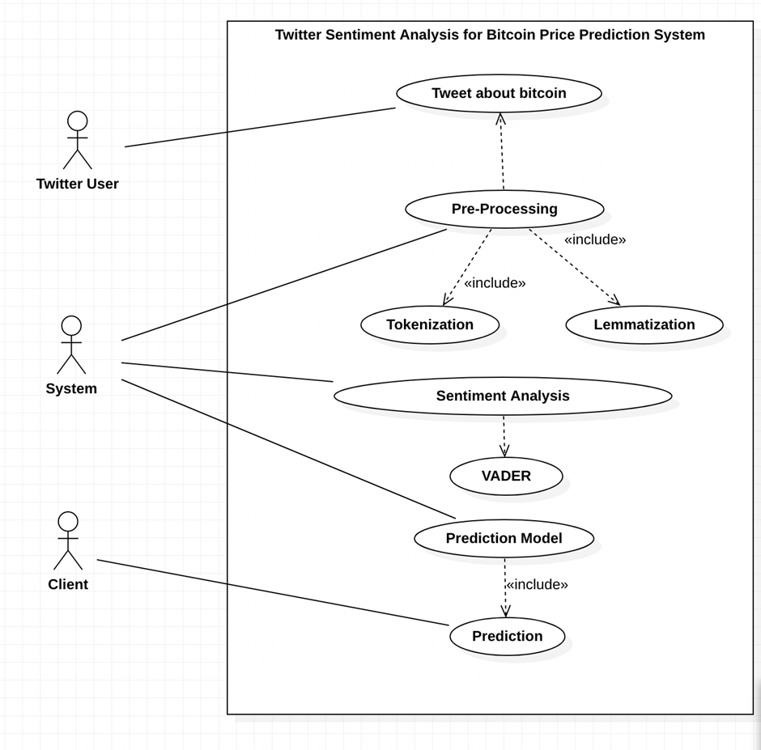
Use case diagram

Slide 13
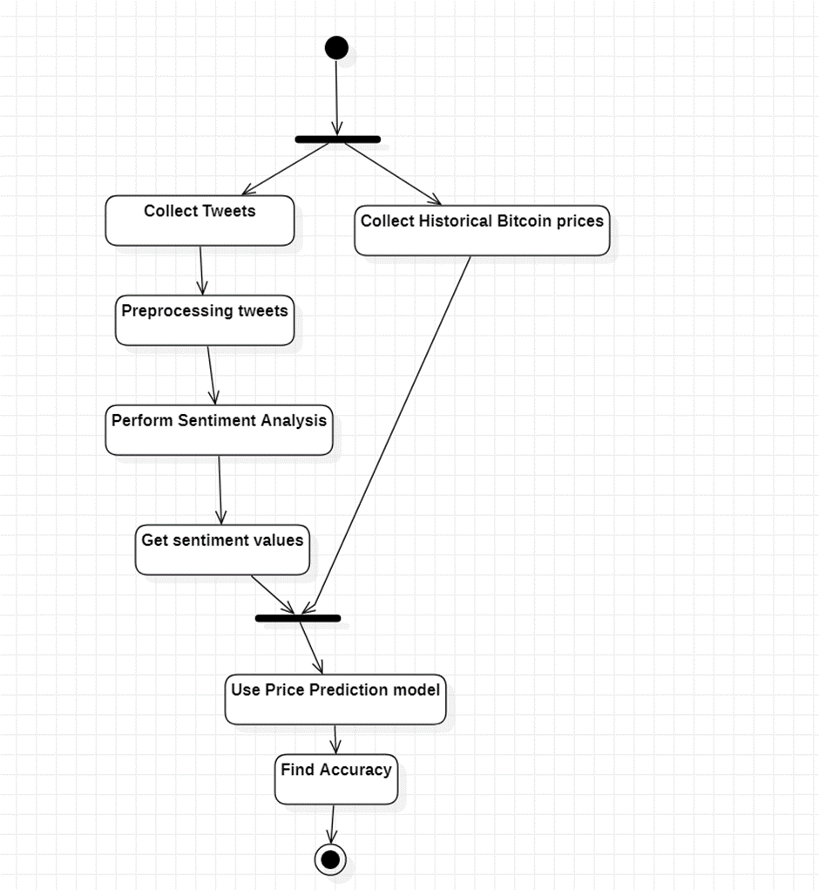
Activity Diagram

Slide 14
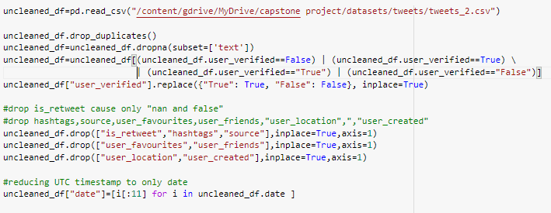
Code Implementation
Cleaning the tweets Dataset

Slide 15
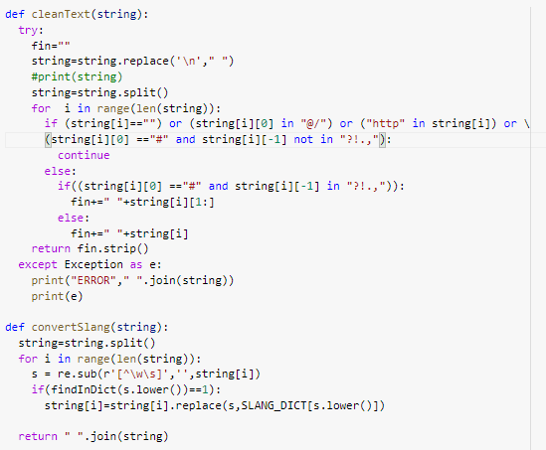
Code Implementation
Tweet Preprocessing

Slide 16
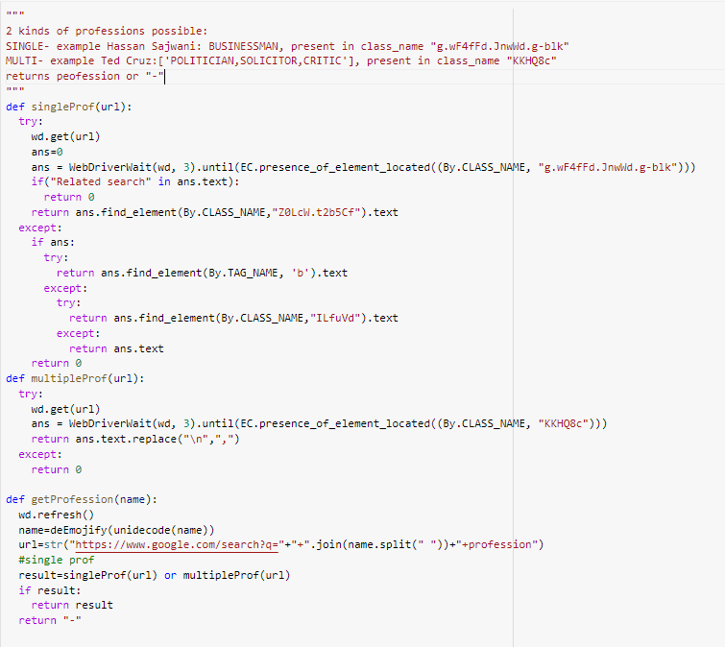
Code Implementation
Assigning profession score

Slide 17
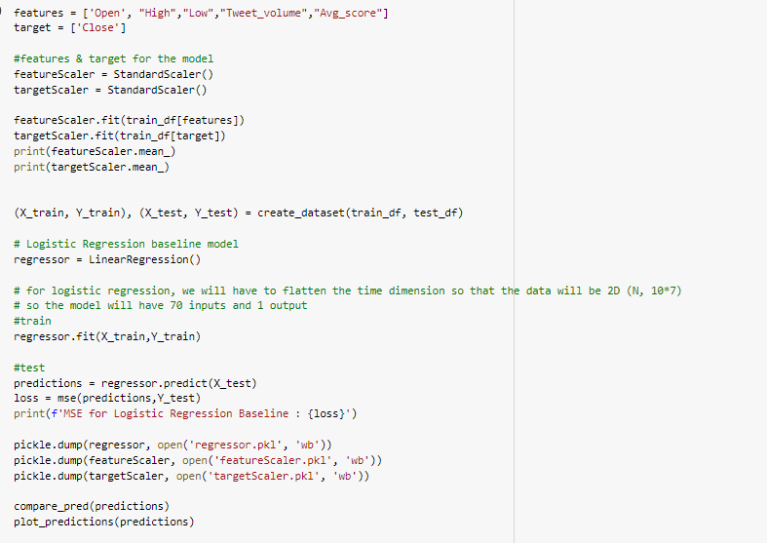
Code Implementation
Model

Slide 18
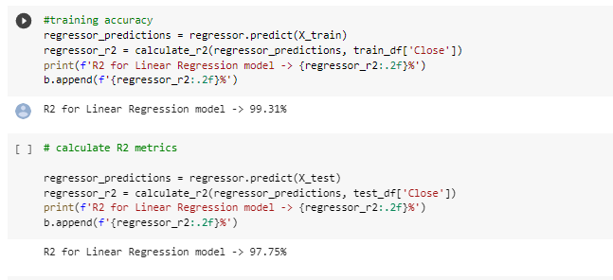
Code Implementation
Accuracy

Slide 19
Environment used
Interface used:
Google colab
Python Modules used:
pandas
Beautiful soup
requests
tqdm
drive
VaderSentiment
nltk
re
sklearn
tensorflow

Slide 20
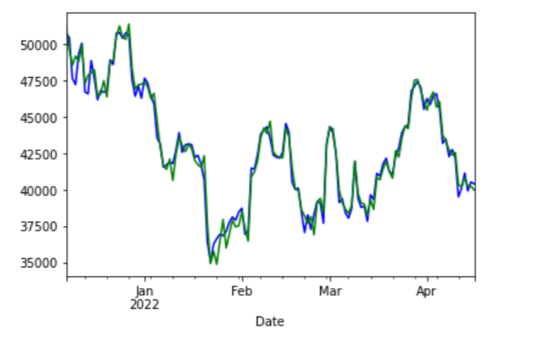
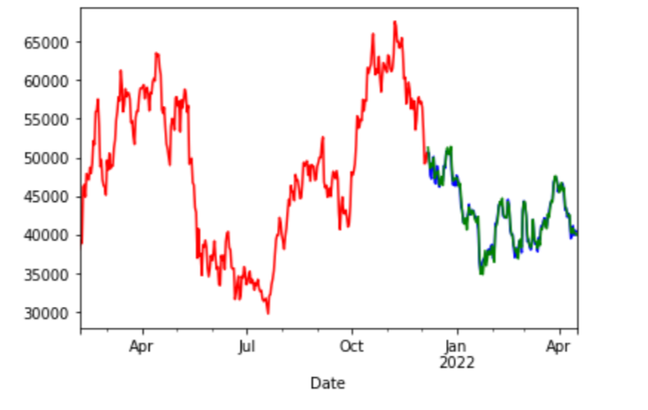
Results and Discussion
linear regression
red-train data values
blue-test data values
green –predictions

Slide 21
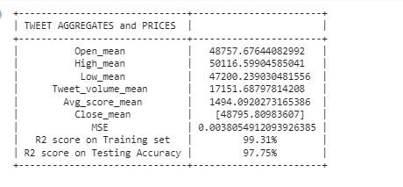
Results and Discussion
MSE of linear regression - 0.0038
Training accuracy- 99.31
Test accuracy- 97.75
Linear regression has high accuracy.
The results obtained are as per initial estimates.

Slide 22
Timeline
Project is completed.
Project report completed.

Slide 23
Conclusion
Model was developed to predict the bitcoin price
using sentiment of tweets, previous price data and
professions of users.

Slide 24
References
Abraham, Jethin; Higdon, Daniel; Nelson, John; and Ibarra, Juan (2018) "Cryptocurrency Price Prediction Using Tweet Volumes and Sentiment Analysis," SMU Data Science Review: Vol. 1 : No. 3 , Article 1
D. R. Pant, P. Neupane, A. Poudel, A. K. Pokhrel and B. K. Lama, "Recurrent Neural Network Based Bitcoin Price Prediction by Twitter Sentiment Analysis," 2018 IEEE 3rd International Conference on Computing, Communication and Security (ICCCS), 2018, pp. 128-132, doi: 10.1109/CCCS.2018.8586824.

Slide 25
References
E. Edgari, J. Thiojaya and N. N. Qomariyah, "The Impact of Twitter Sentiment Analysis on Bitcoin Price during COVID-19 with XGBoost," 2022 5th International Conference on Computing and Informatics (ICCI), 2022, pp. 337-342, doi: 10.1109/ICCI54321.2022.9756123.
E. Şaşmaz and F. B. Tek, "Tweet Sentiment Analysis for Cryptocurrencies," 2021 6th International Conference on Computer Science and Engineering (UBMK), 2021, pp. 613-618, doi: 10.1109/UBMK52708.2021.955891
Twitter Sentiment Analysis for Bitcoin Price Prediction - Sara Abdali Ben Hoskins 2021

Slide 26
References
O. Sattarov, H. S. Jeon, R. Oh and J. D. Lee, "Forecasting Bitcoin Price Fluctuation by Twitter Sentiment Analysis," 2020 International Conference on Information Science and Communications Technologies (ICISCT), 2020, pp. 1-4, doi: 10.1109/ICISCT50599.2020.9351527.

Slide 27
Thank You

